Slide 1
INDOOR POSITIONING SYSTEM USING DEEP LEARNING
Clyde Noronha
Mustafa Zaki
Shane Gracias
Ruman Mulla

Slide 2
Objective
The objective of this project is to provide the accurate, real-time indoor location of a user using deep learning, with the help of the accelerometer and gyroscope sensors available in smartphones.

Slide 3
Introduction
Global Positioning Systems (GPS) are limited to an accuracy of up to 5m, hence are not helpful indoors.
Indoor Positioning Systems (IPS) are a solution to locate oneself indoors.
Several approaches such as WLAN, Bluetooth, Geomagnetic Fingerprinting and Inertial Sensors.
Our approach is based on inertial sensors present in smartphones, using deep learning to improve the accuracy.
It is purely software based, and requires the user to just download an application and use it.
Significant applications include personal indoor navigation, healthcare monitoring and security.

Slide 4
PROPOSED WORK & IMPLEMENTATION

Slide 5
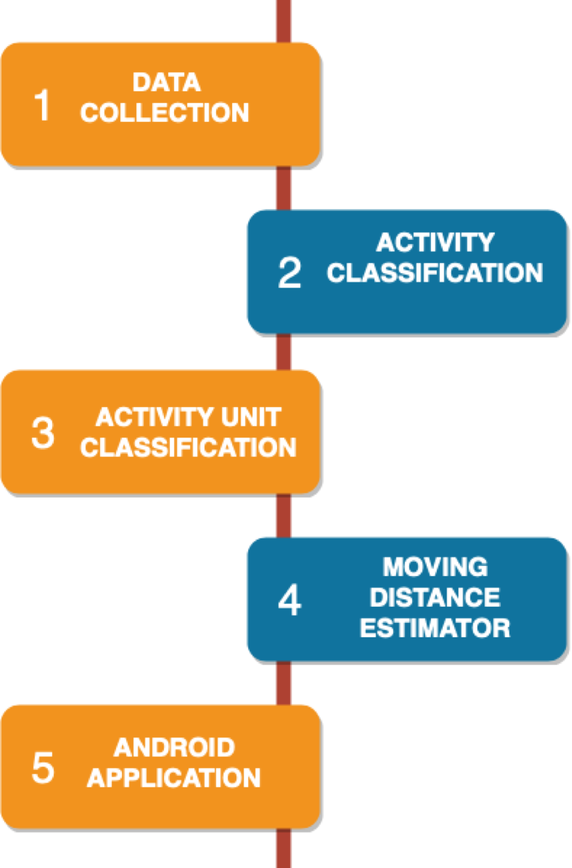
Level 0 Design Flow Diagram.

Slide 6
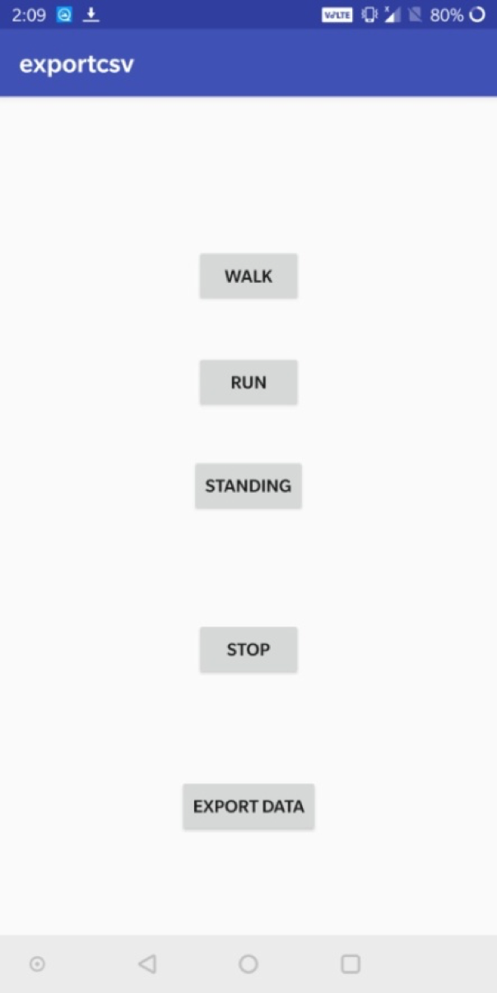
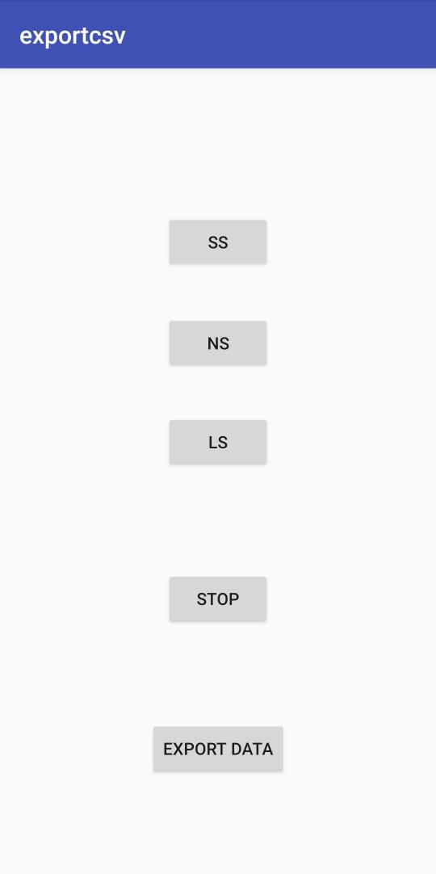
Data Collection
We built a simple app using Android Studio to collect accelerometer and gyroscope sensor data and store it in a .csv file.
Three buttons are provided to collect the data according to the activity or activity unit being performed. The data is recorded with a frequency of 50Hz. Once the data is recorded, we export it to a file.

Slide 7
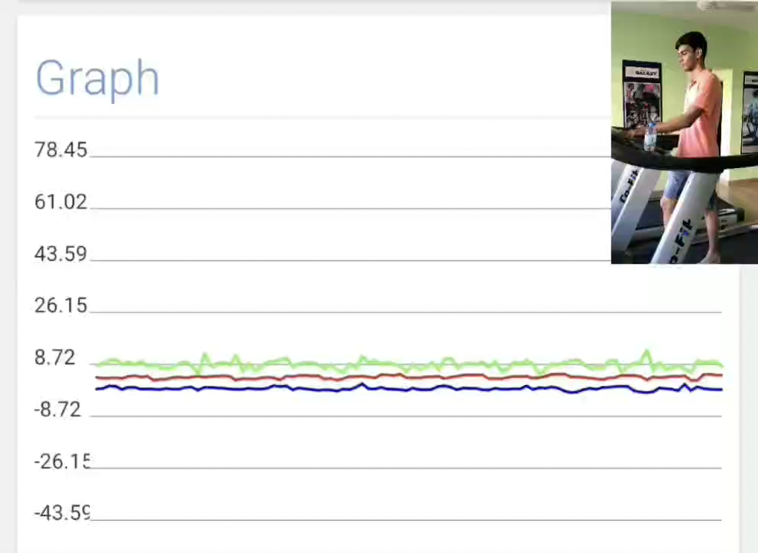
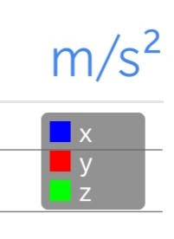
Collection of Accelerometer Data for Walking and Running

Slide 8
Activity Data
Previously, we had used the dataset obtained from Wireless Sensor Data Mining (WISDM) Lab containing 1,098,207 records.
However, it was discarded as it was incapable of accurately classifying data for our use case.
Hence, we collected our own activity data for the Activity Classification LSTM using the Data Collection app.

Slide 9
Activity Data
Label | Speed Setting
Standing | 0
Walking | 3
Running | 5.6
Data was collected on a treadmill with following speed setting corresponding to each label.
Label | No. of Records
Standing | 75,903
Walking | 90,584
Running | 57,903
The final dataset contained 2,24,390 records of the following labels.

Slide 10
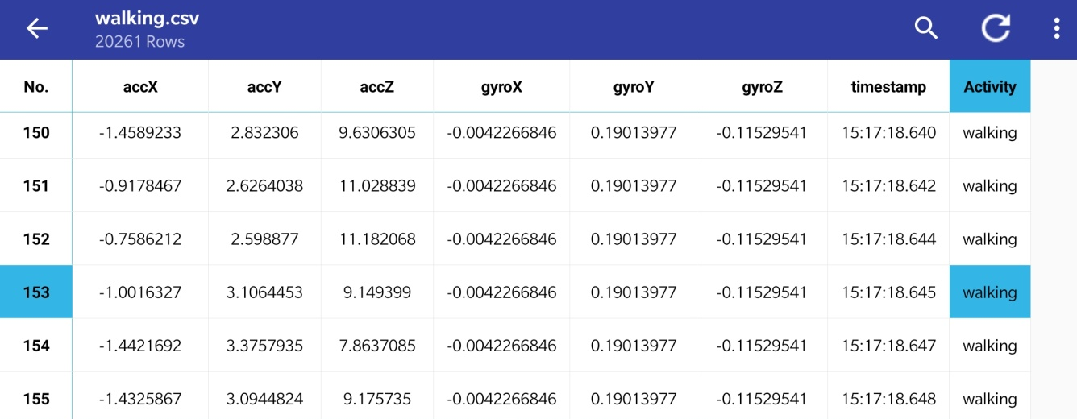
Activity Data

Slide 11
Activity Unit Data
We also collected our own data for the Activity Unit LSTM using the Data Collection app.
Label | Step Length (cm)
Short Step (SS) | 42
Normal Step (NS) | 75
Long Step (LS) | 92
Data was collected along a straight footpath with the following average step length corresponding to each label
Label | No. of Records
Short Step (SS) | 76,917
Normal Step (NS) | 64,210
Long Step (LS) | 90,412
The final dataset contained 2,31,544 records.

Slide 12
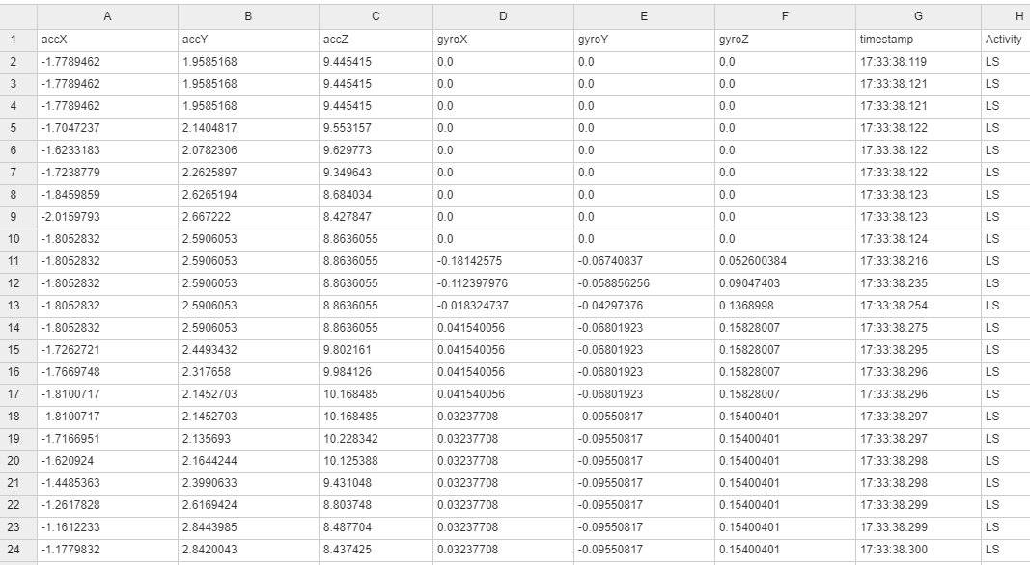
Activity Unit Data

Slide 13
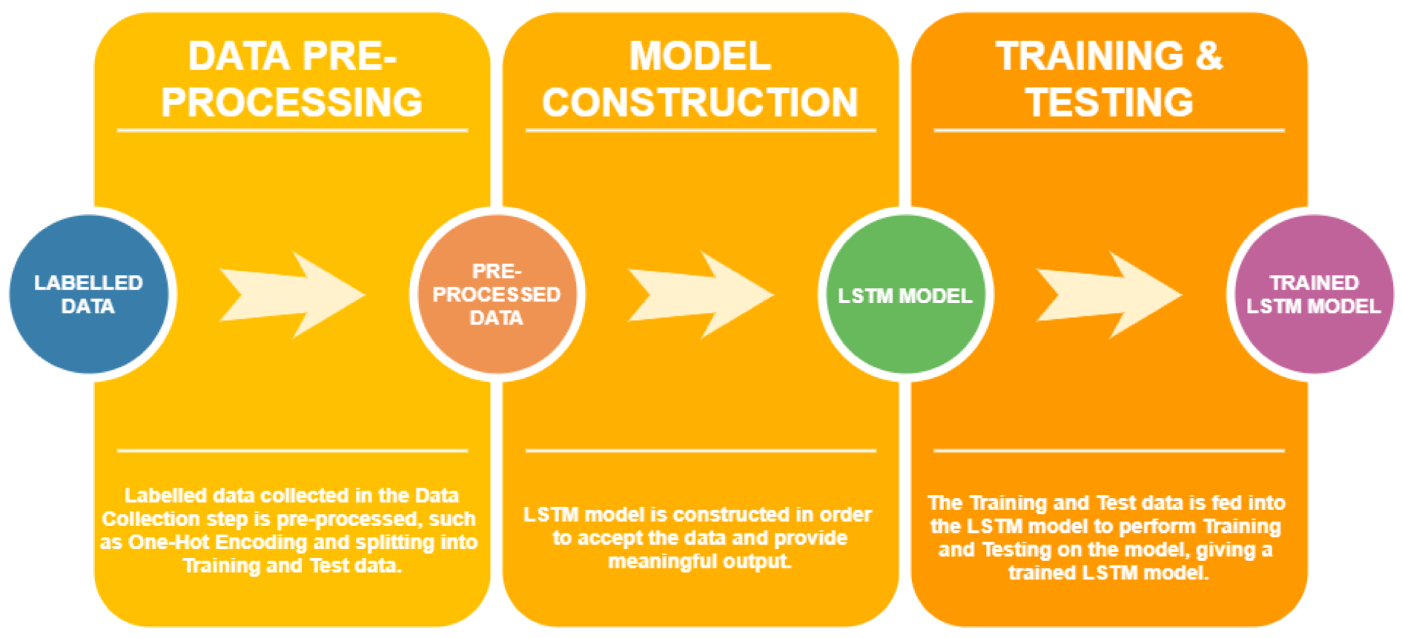
Activity Classification
The Activity Classification phase classifies the activities being performed by the user (Walking, Running, Standing) using an LSTM.
We have collected 2,23,816 records of data, and we use 3 features (accelerometer X, Y and Z) in order to build the model to output class labels as Walking, Running or Standing. There are 3 steps involved: 1. Data Pre-processing 2. Model Construction 3. Model Training & Testing
In addition, we created an android app to test the model.
Level 1 LSTM Design Flow Diagram

Slide 14
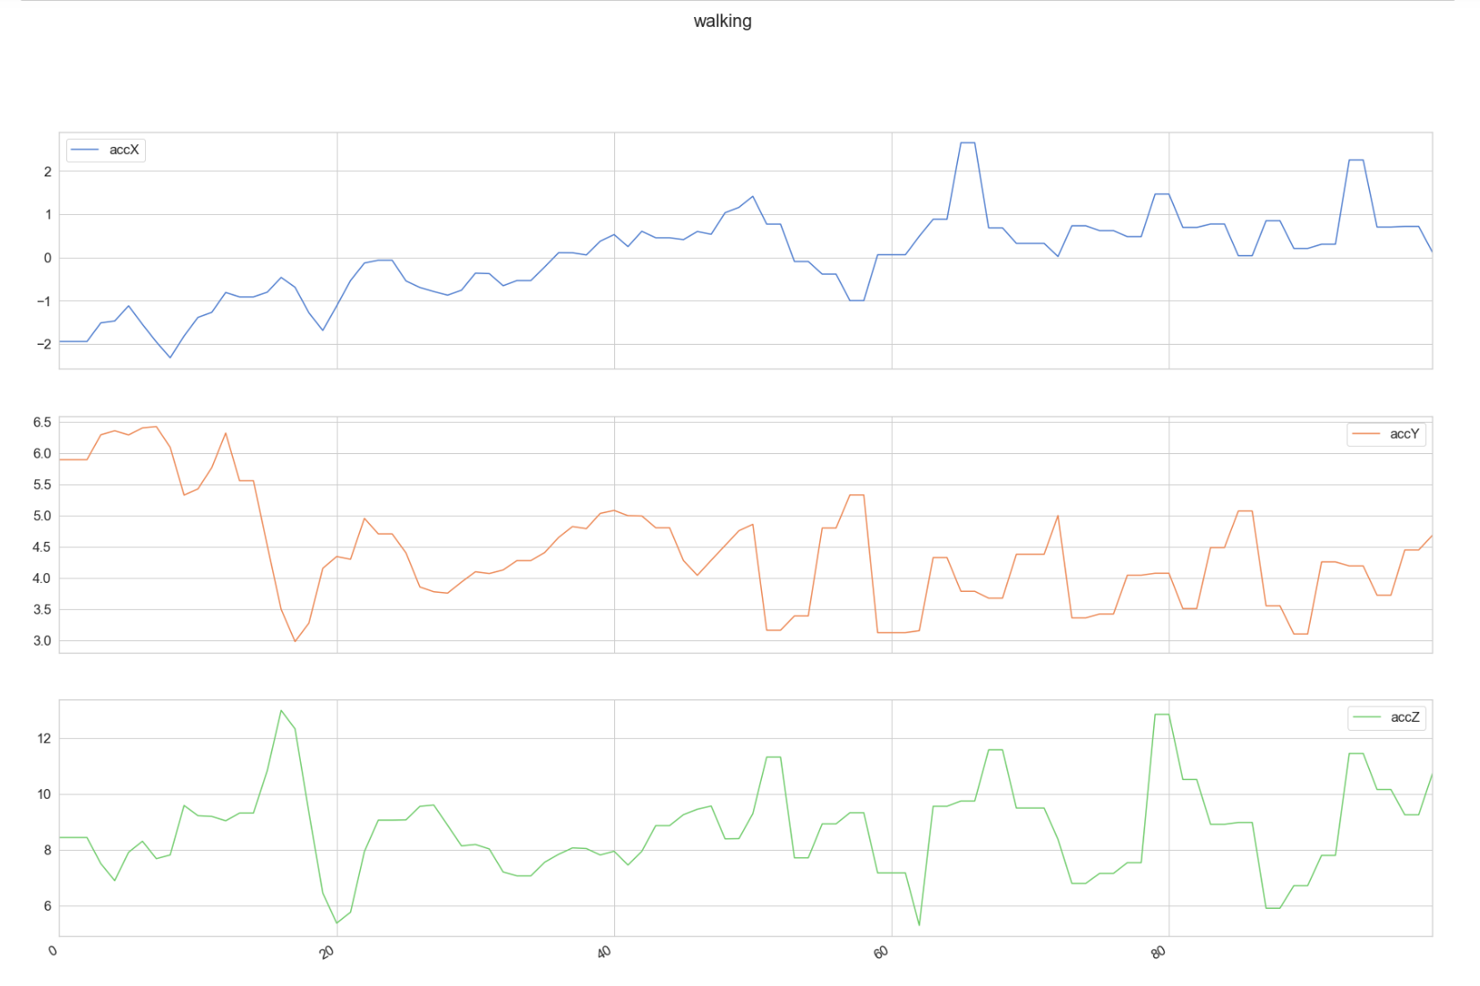
The number of training records for each type of activity were:
Standing – 75,903
Walking – 90,584
Running – 57,903
Sample Accelerometer Data for Walking

Slide 15
Activation Function – Softmax
Optimizer – Adam Optimizer
1. Data Pre-processing The data is transformed to include only the accelerometer x-axis, y-axis and z-axis data i.e. 3 features.
One-Hot Encoding is performed.
The data is split into training (80%) and test (20%) data.
2. Model Construction The LSTM model contains 2 LSTM layers stacked on top of each other with 64 hidden units each. Activation Function – Softmax.
The parameters used are as follows:
No of Features | No of Classes | Shape of Input | Shape of Output
3 | 3 | {1, 100, 3} | {3}
No of Samples | Learning Rate | No of Epochs | Batch Size
100 | 0.0025 | 40 | 1024

Slide 16
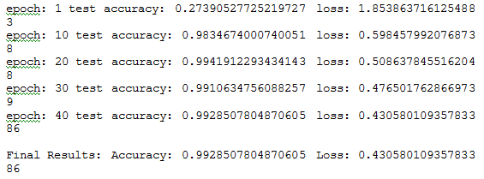
3. Model Training & Testing
40 epochs with batch size of 1024.
The output is the train and test loss and accuracy.
A working model is created, which can be exported and used further.
Final Accuracy – 99.3%
OUTPUT

Slide 17
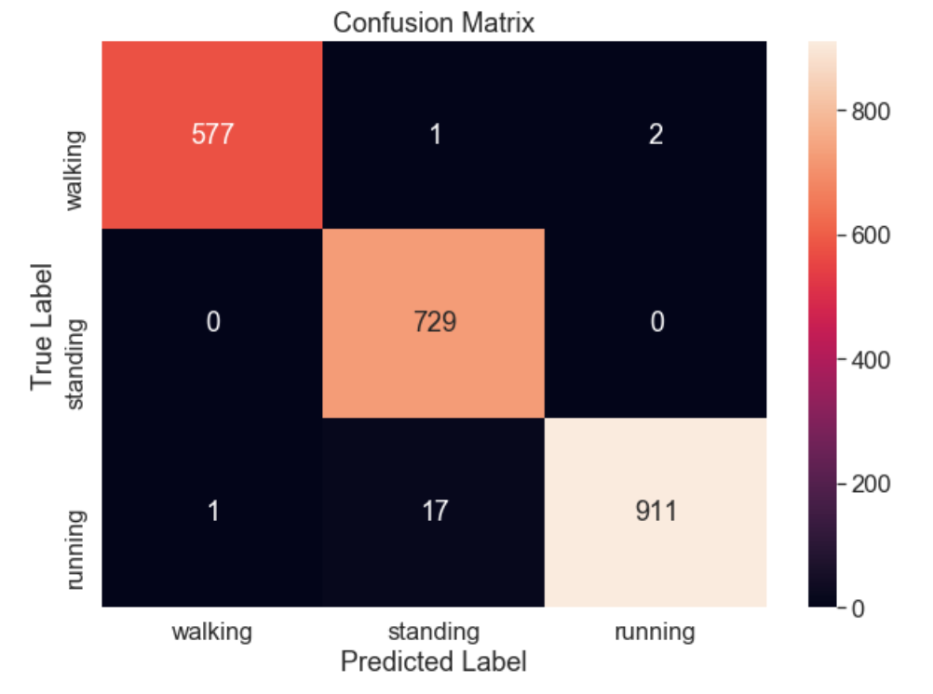
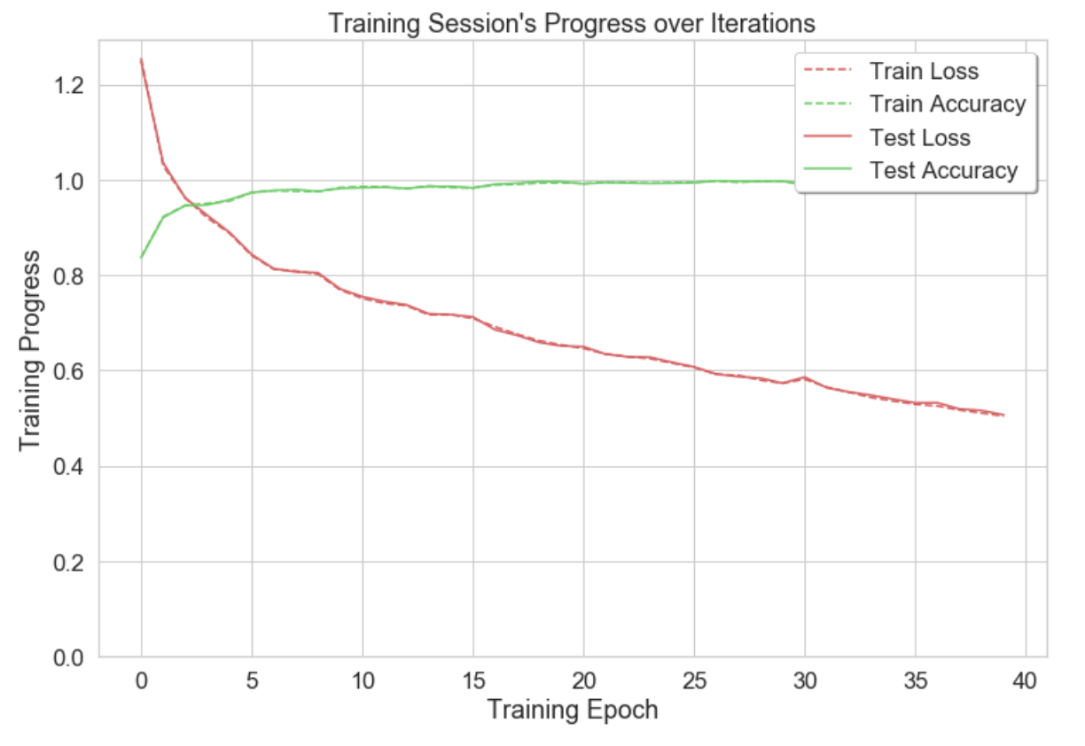

Slide 18
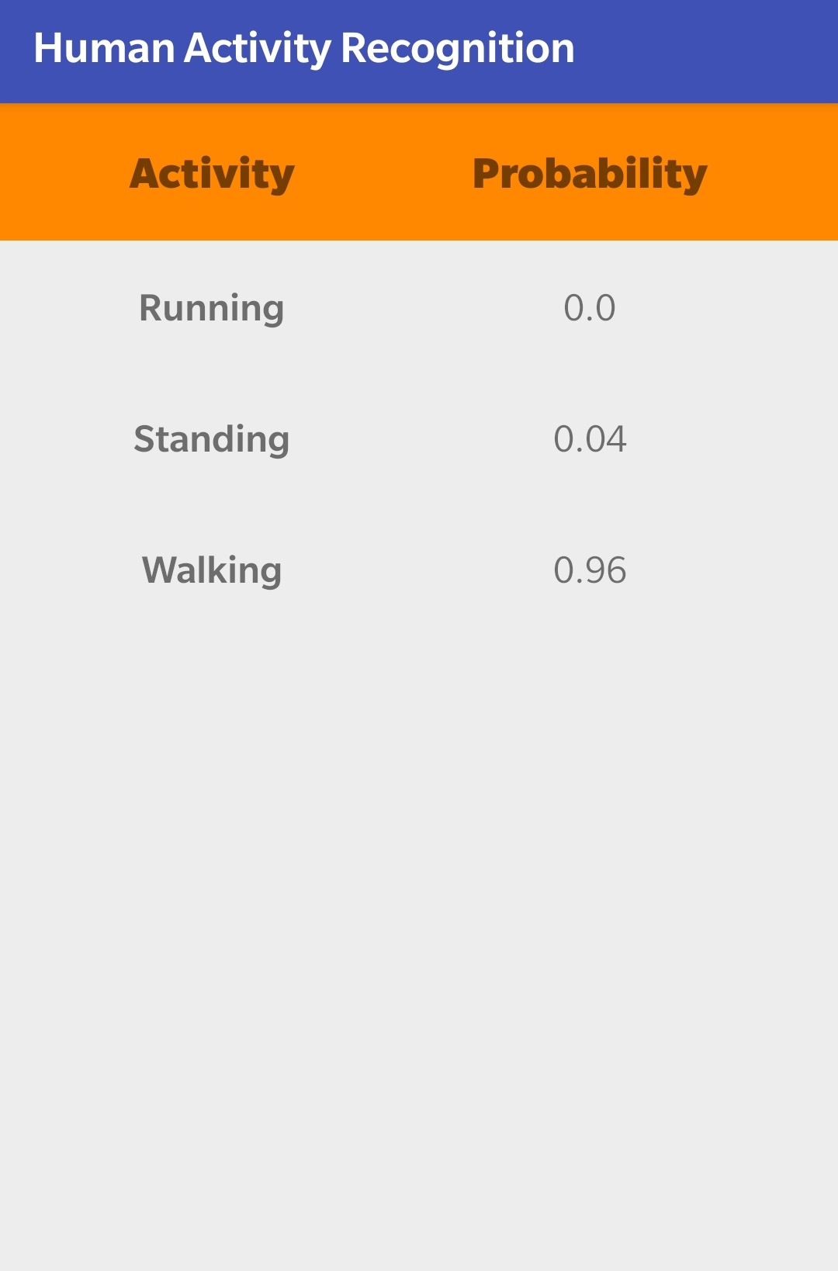
Basic android app that interfaces with the LSTM model to check if the predictions of the model are accurate.
Consists of a table with the class labels with the corresponding probability that it is occurring.
Activity with the highest probability is voiced out loud using text to speech.

Slide 19
Activity Unit (AU) Classification
Data
The dataset contains approx. 2 lakh records
LS=64,879
NS=64,711
SS=64,206
The data was collected with a frequency of 50Hz.
Data Preprocessing
The LSTM was trained with fixed sequences of data with sample size=100.
One-hot encoding was also performed before constructing the model.
The data was then split into Training (80%) and Testing data (20%).

Slide 20
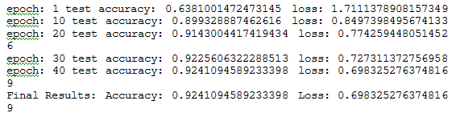
Model Construction
The model was constructed similar to the LSTM of Activity Classification.
Inputs fed into the LSTM were acc_x, acc_y, acc_z.
The model contains three labels:
Short Step
Normal Step
Long Step
Training and Testing
The training and testing was performed on the constructed model for 40 epochs.
The sequences of data are fed into the LSTM as input.
The final accuracy = 92.4%.

Slide 21
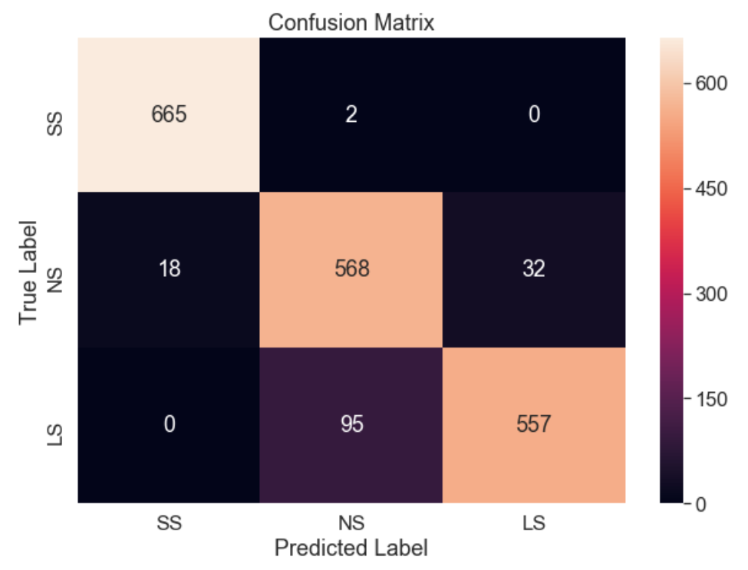
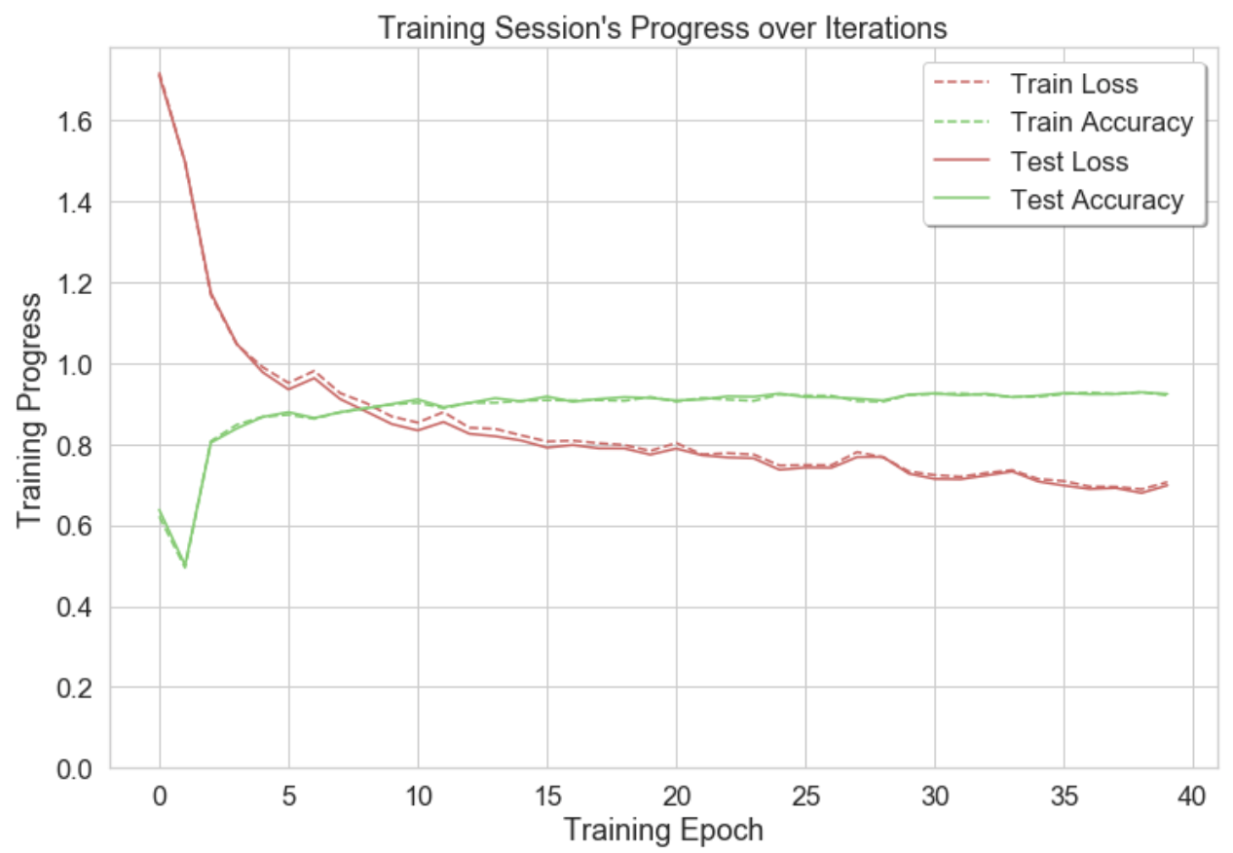

Slide 22
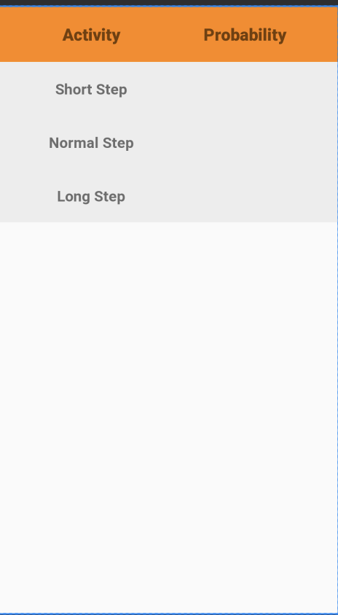
Android App
We built an android application with a simple user interface and exported the saved model to the app to check if it predicts the type of user step accurately with minimum delay.

Slide 23
Moving Distance Estimator
Works on principle that “a person will walk along a path with a consistent step type, unless an obstacle occurs.”
Output of Activity Unit Classification LSTM (SS, NS, LS) will be fed into the Moving Distance Estimator.
Estimator has a buffer of a particular size, initially empty. It stores the step type values.
If the buffer is full, the oldest value is discarded and the new value enters.
The mode is calculated continuously, and the output is considered as the step type of that particular moment in time.
The step type is converted to an actual step length value according to the user’s height.
The step length is outputted from the Estimator and given as an input for the movement of the Blue Dot in the final Android app.
Notes:
This ensures that if the LSTM provides a single reading that is different from the other readings in the buffer, it will not consider it. The Estimator will only consider a reading if it occurs consistently.

Slide 24
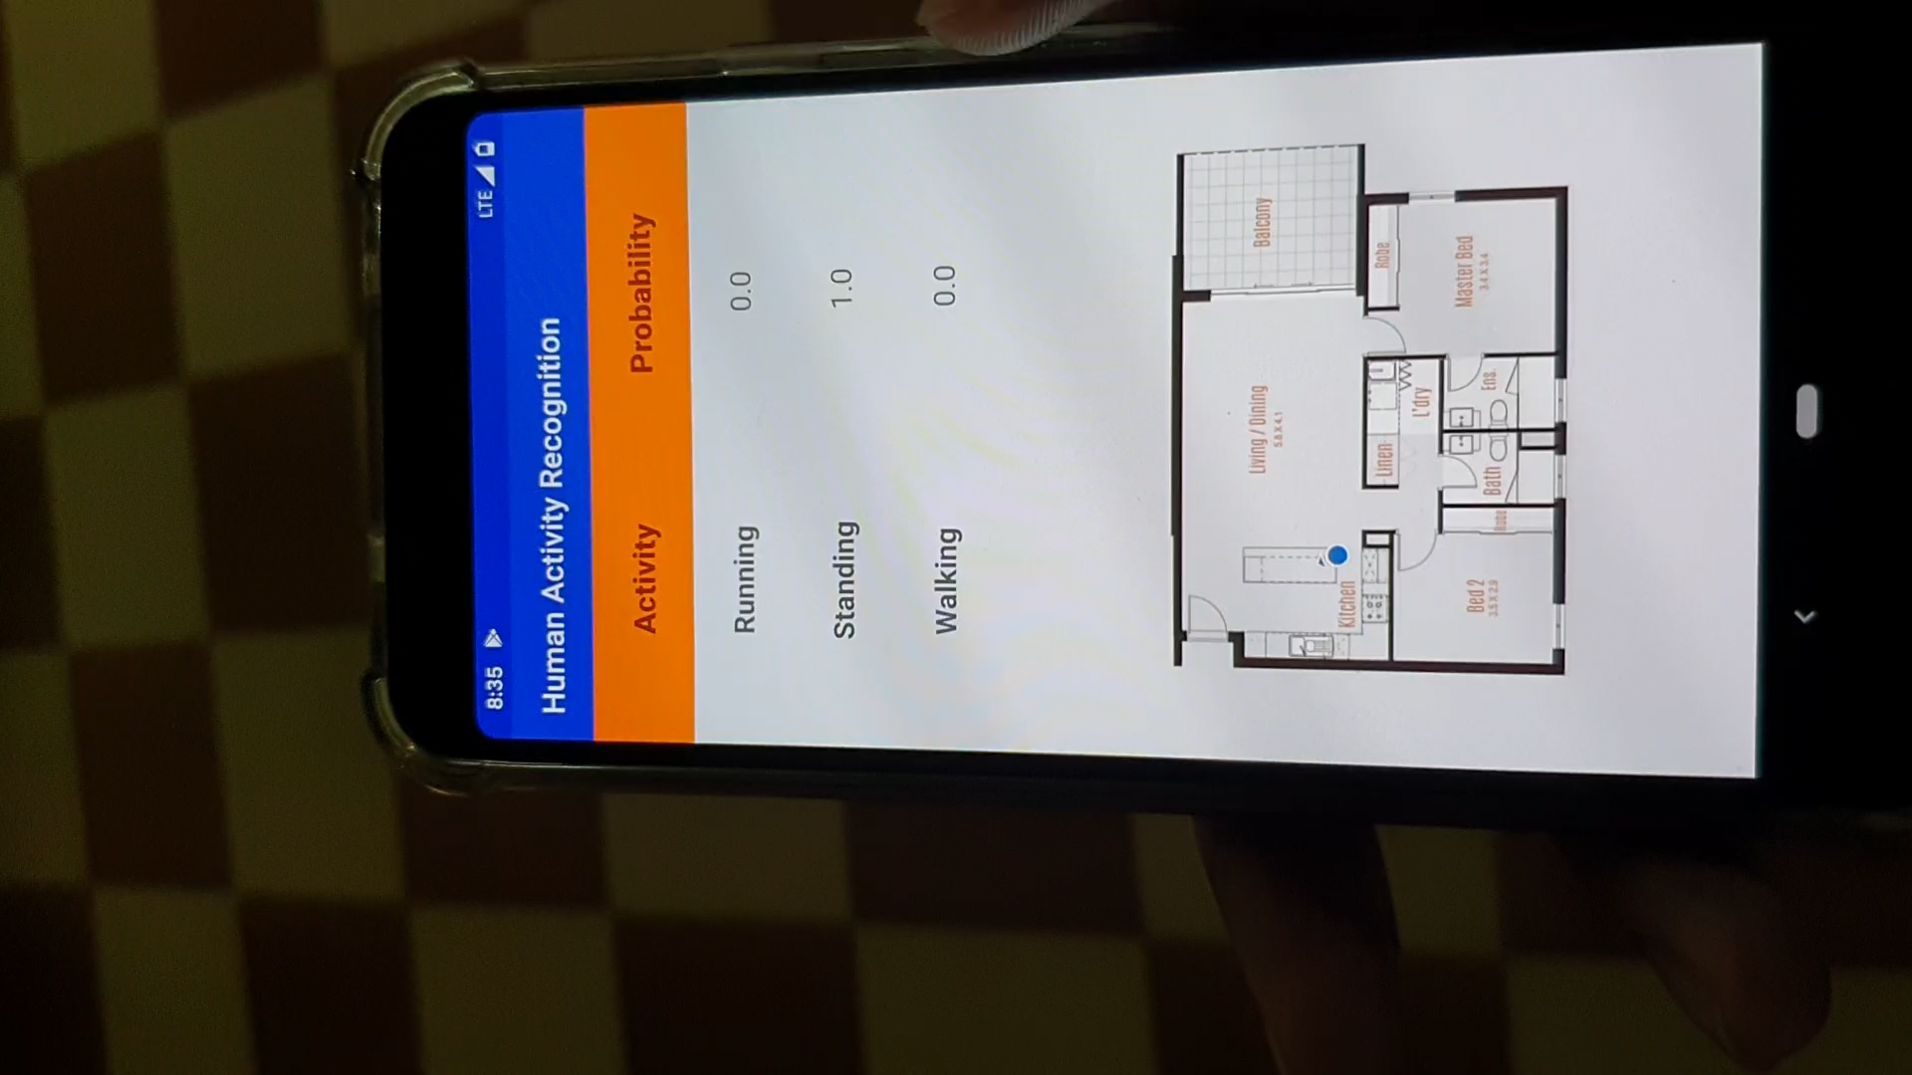
Positioning App Demo

Slide 25
Compute the Device’s Orientation
By computing a device's orientation, you can monitor the position of the device relative to the earth's frame of reference (specifically, the magnetic north pole).
The system computes the orientation angles by using a device's geomagnetic field sensor in combination with the device's accelerometer. Using these two hardware sensors, the system provides data for the following three orientation angles:
Azimuth (degrees of rotation about the -z axis) : This is the angle between the device's current compass direction and magnetic north.
Pitch (degrees of rotation about the x axis) :This is the angle between a plane parallel to the device's screen and a plane parallel to the ground
Roll (degrees of rotation about the y axis). This is the angle between a plane perpendicular to the device's screen and a plane perpendicular to the ground

Slide 26
Updating Device Position
Let (x , y) be the current position of the device.
Θ (Azimuth) is the angle between the device's current compass direction and magnetic north.
x = x + estimatedDistance * cos(θ);
y = y + estimatedDistance * sin(θ);

Slide 27
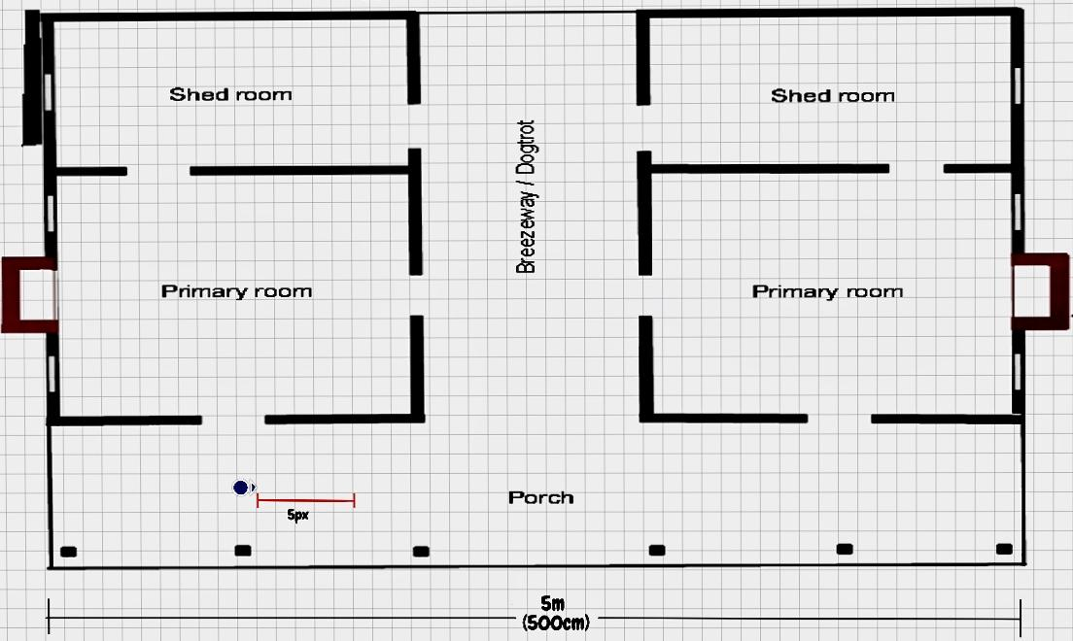
Mapping Example ( 1px = 10cm)

Slide 28
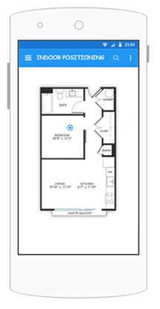
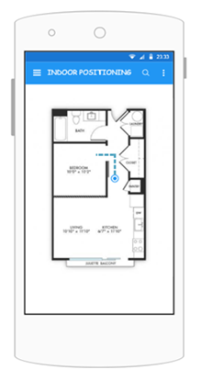
Android Application [Final Mockup]
User selects starting position
User moves and system updates position in real time

